Slide 1


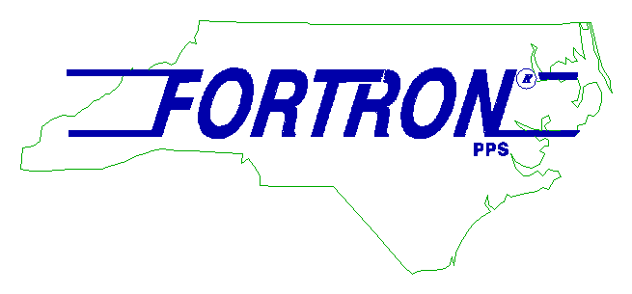






WBD Legacy Investors

